Slide 1


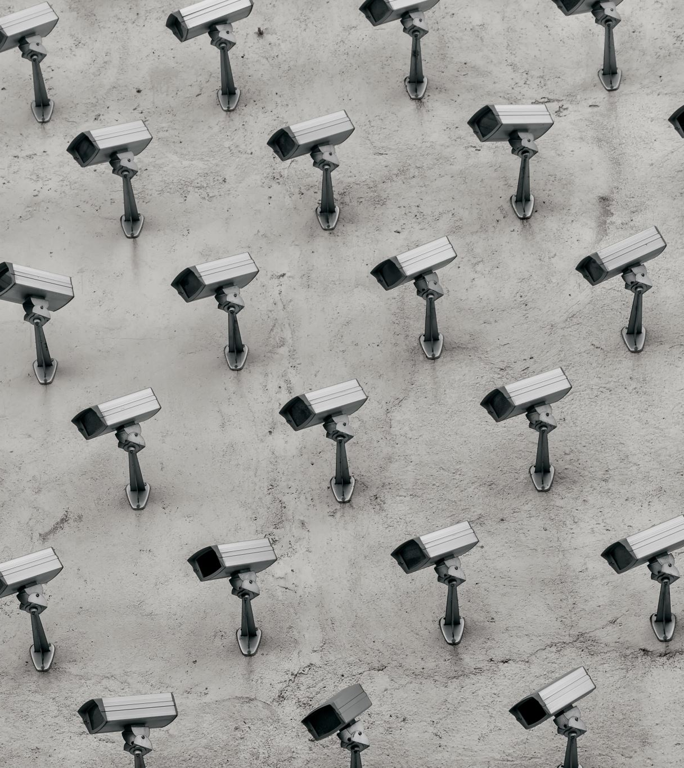
MASS
SURVEILLANCE AND A RIGHT TO PRIVACY (?)

Slide 2
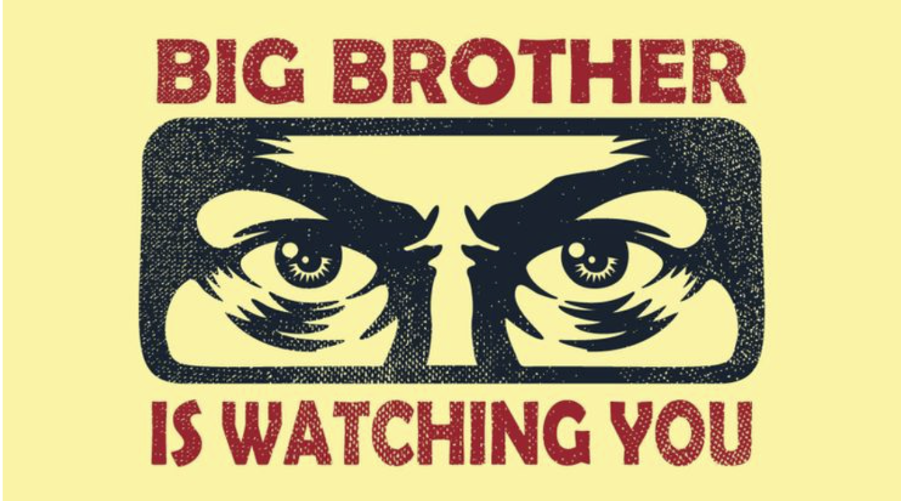

Slide 3
Privacy has ancient roots
‘“whatever, in connection with my professional service, or not in connection with it, I see or hear, in the life of men, which out not to be spoken of abroad, I will not divulge, as reckoning that all such should be kept secret” – Hippocrates, 500 BC
We should have more privacy!

Slide 4
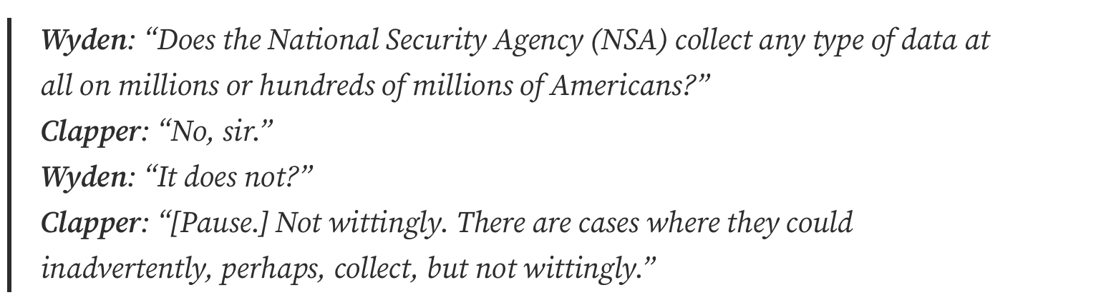
NSA
This was in 2013, before Edward Snowden leaked that the NSA was spying on millions of Americans constantly!
The government is supposed to be for the benefit of society, yet can we really trust it? Or if you have nothing to hide, do you have nothing to fear?

Slide 5
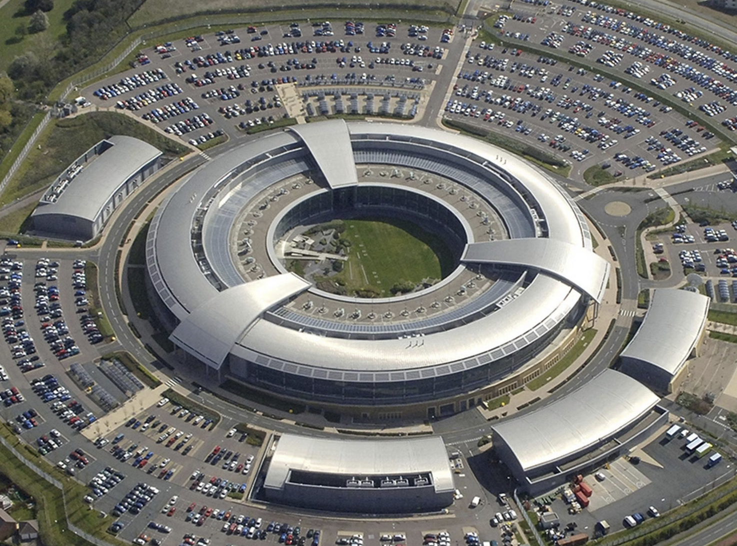
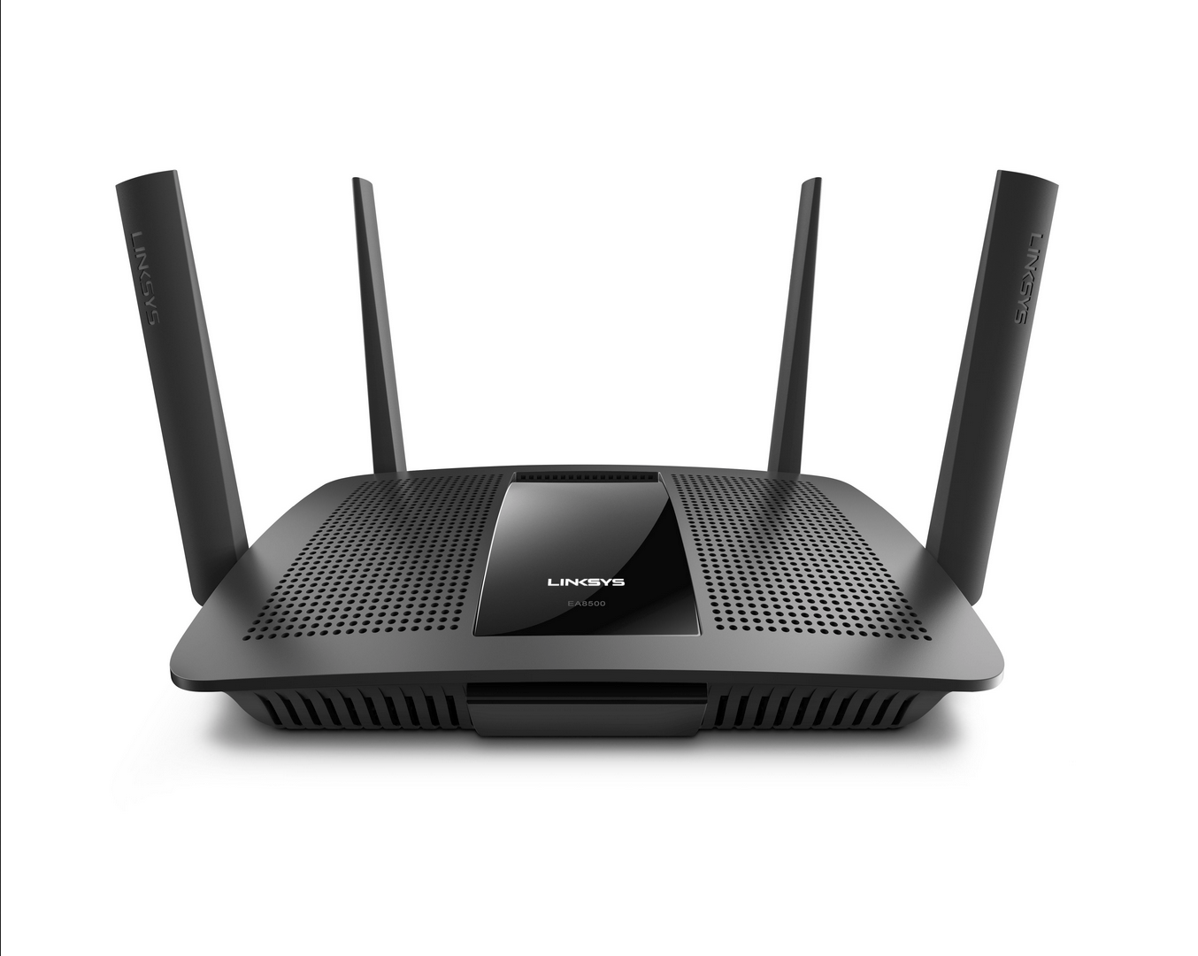
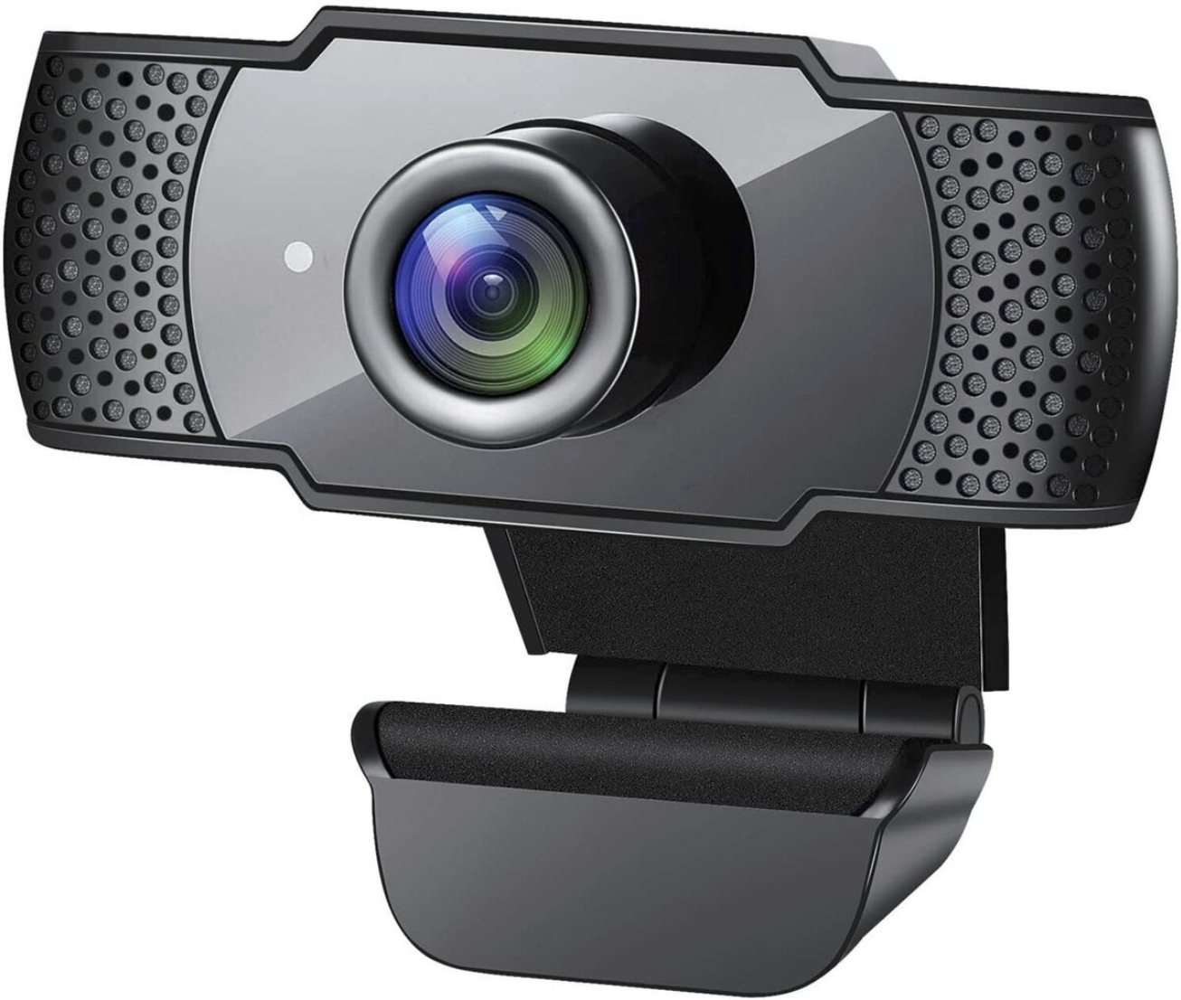
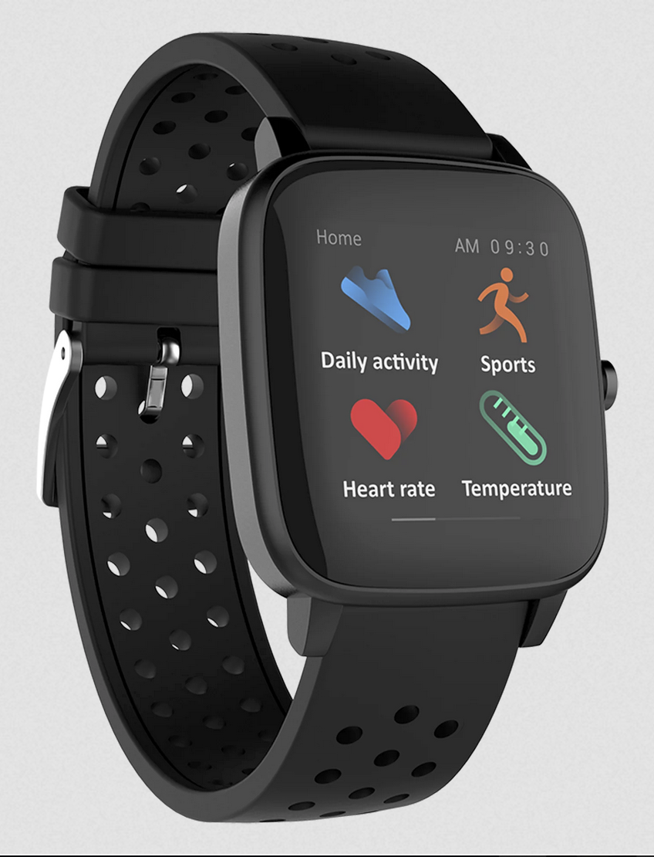
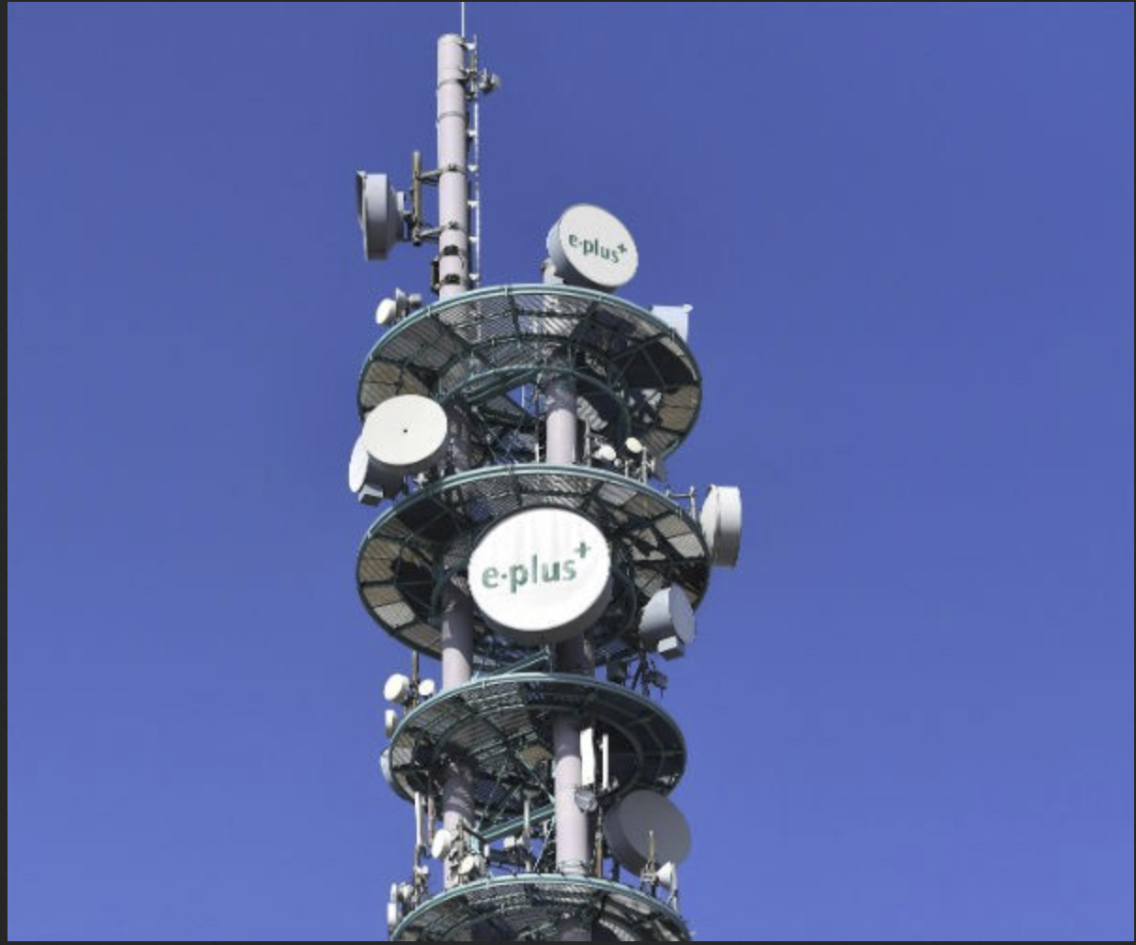
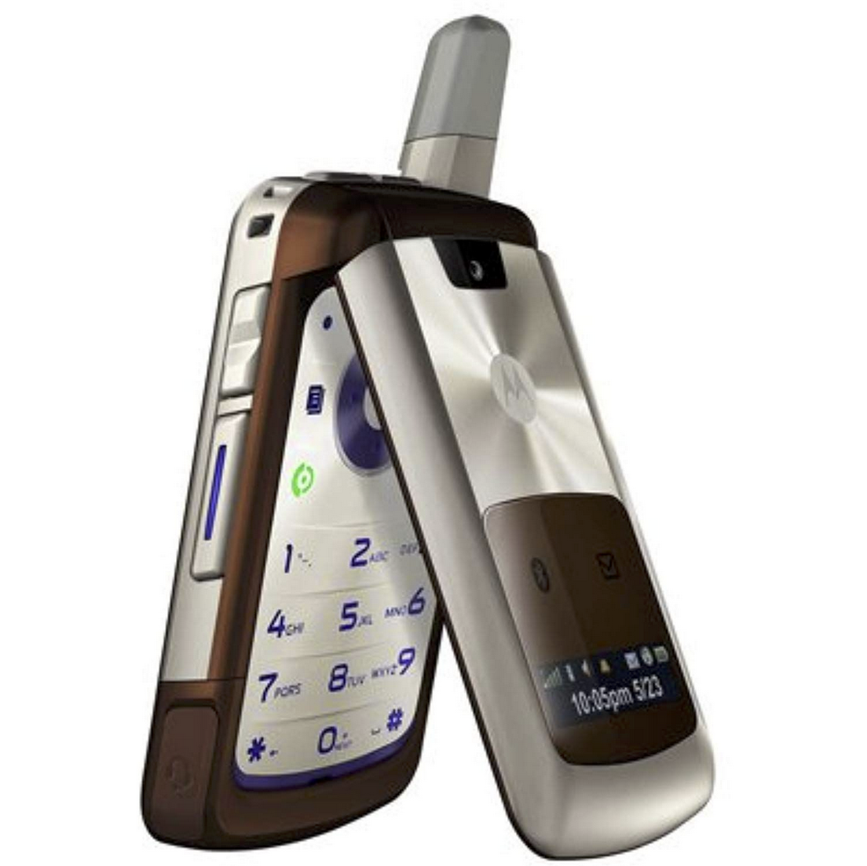
“I have nothing to hide anyway”

Slide 6
What if you had a stalker, that followed your every move? He tracked exactly where you were, what you searched online, everything about you, and kept this information forever?

